Slide 1


Slide 2
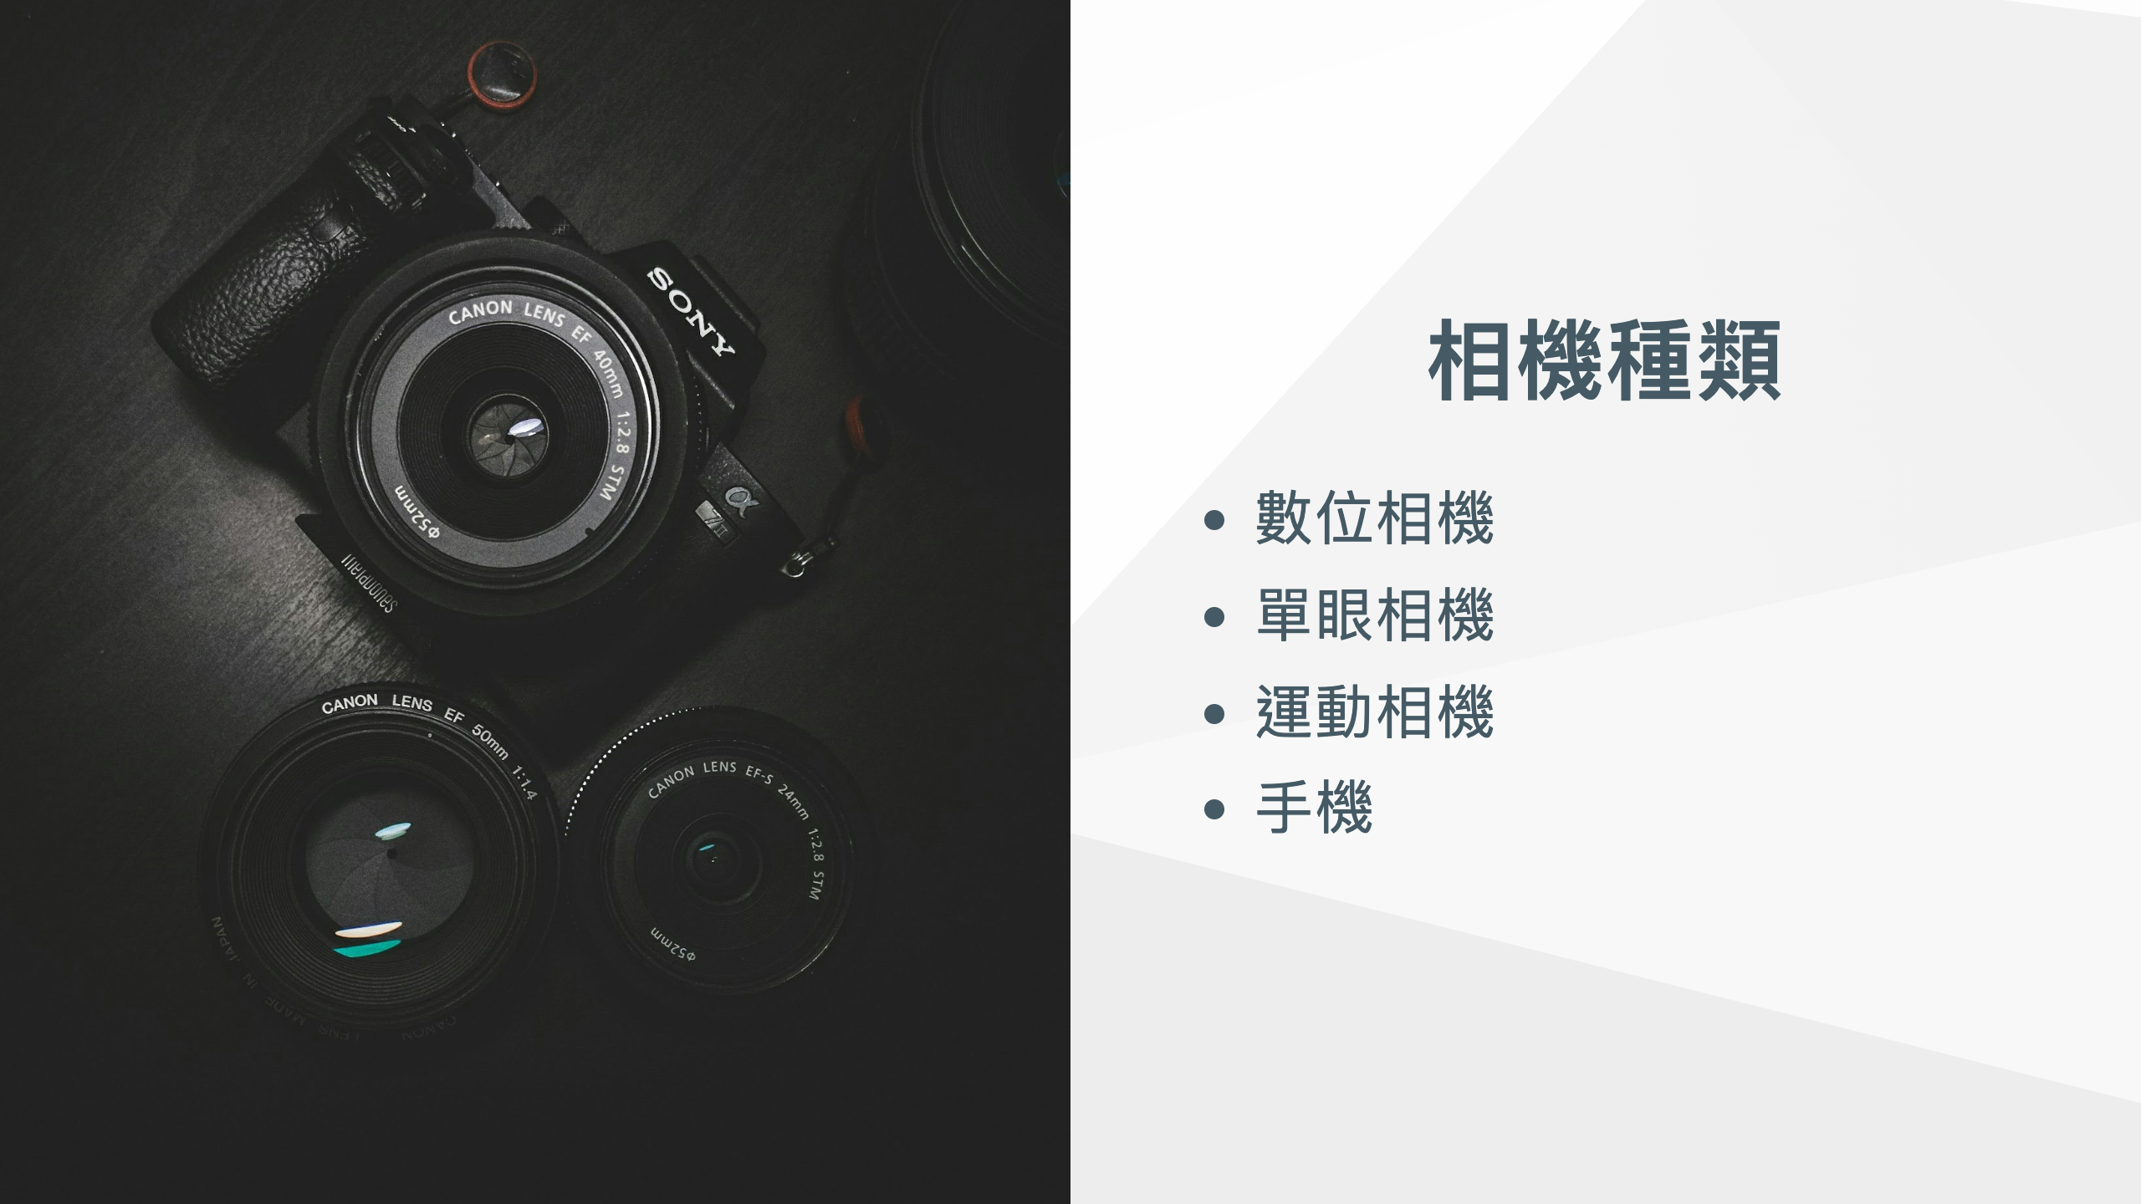
Notes:
![bg left](images/大math-lfRlv3nuf78-unsplash.jpeg) ![bg left](images/大nathan-dumlao-McztPB7Uqx8-unsplash.jpeg)

Slide 3
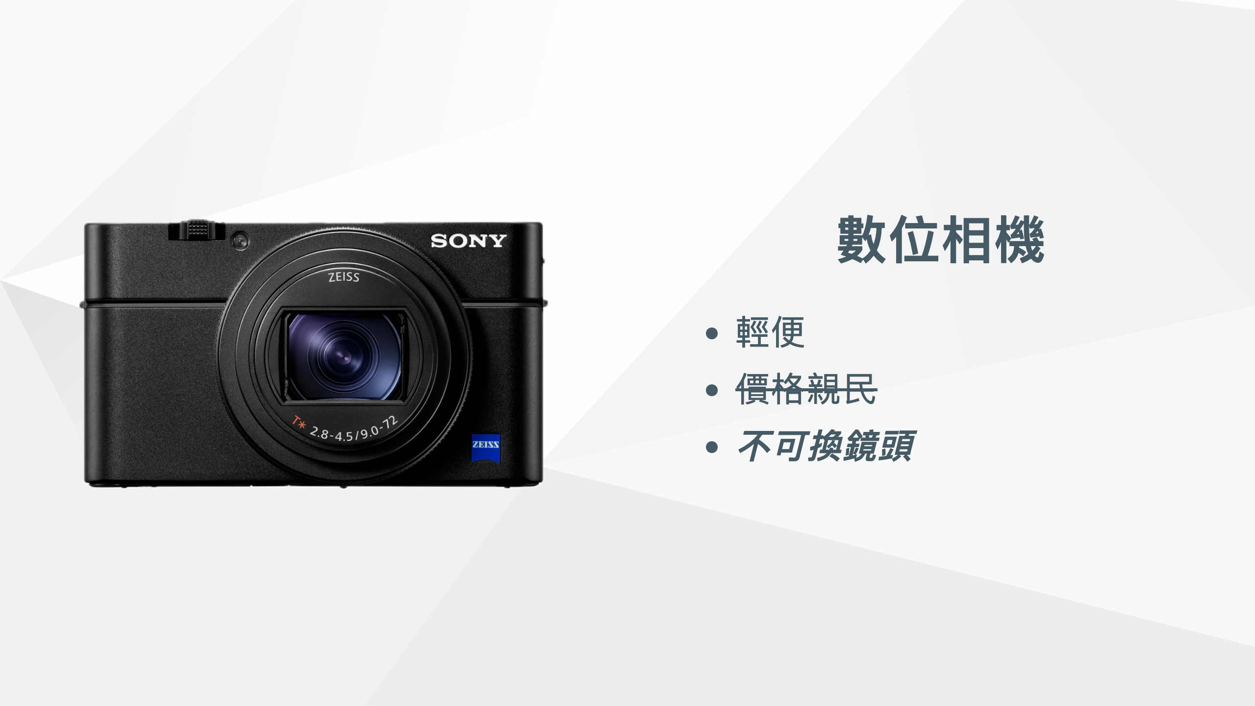
Notes:
## RX100 VII

Slide 4


Slide 5


Slide 6
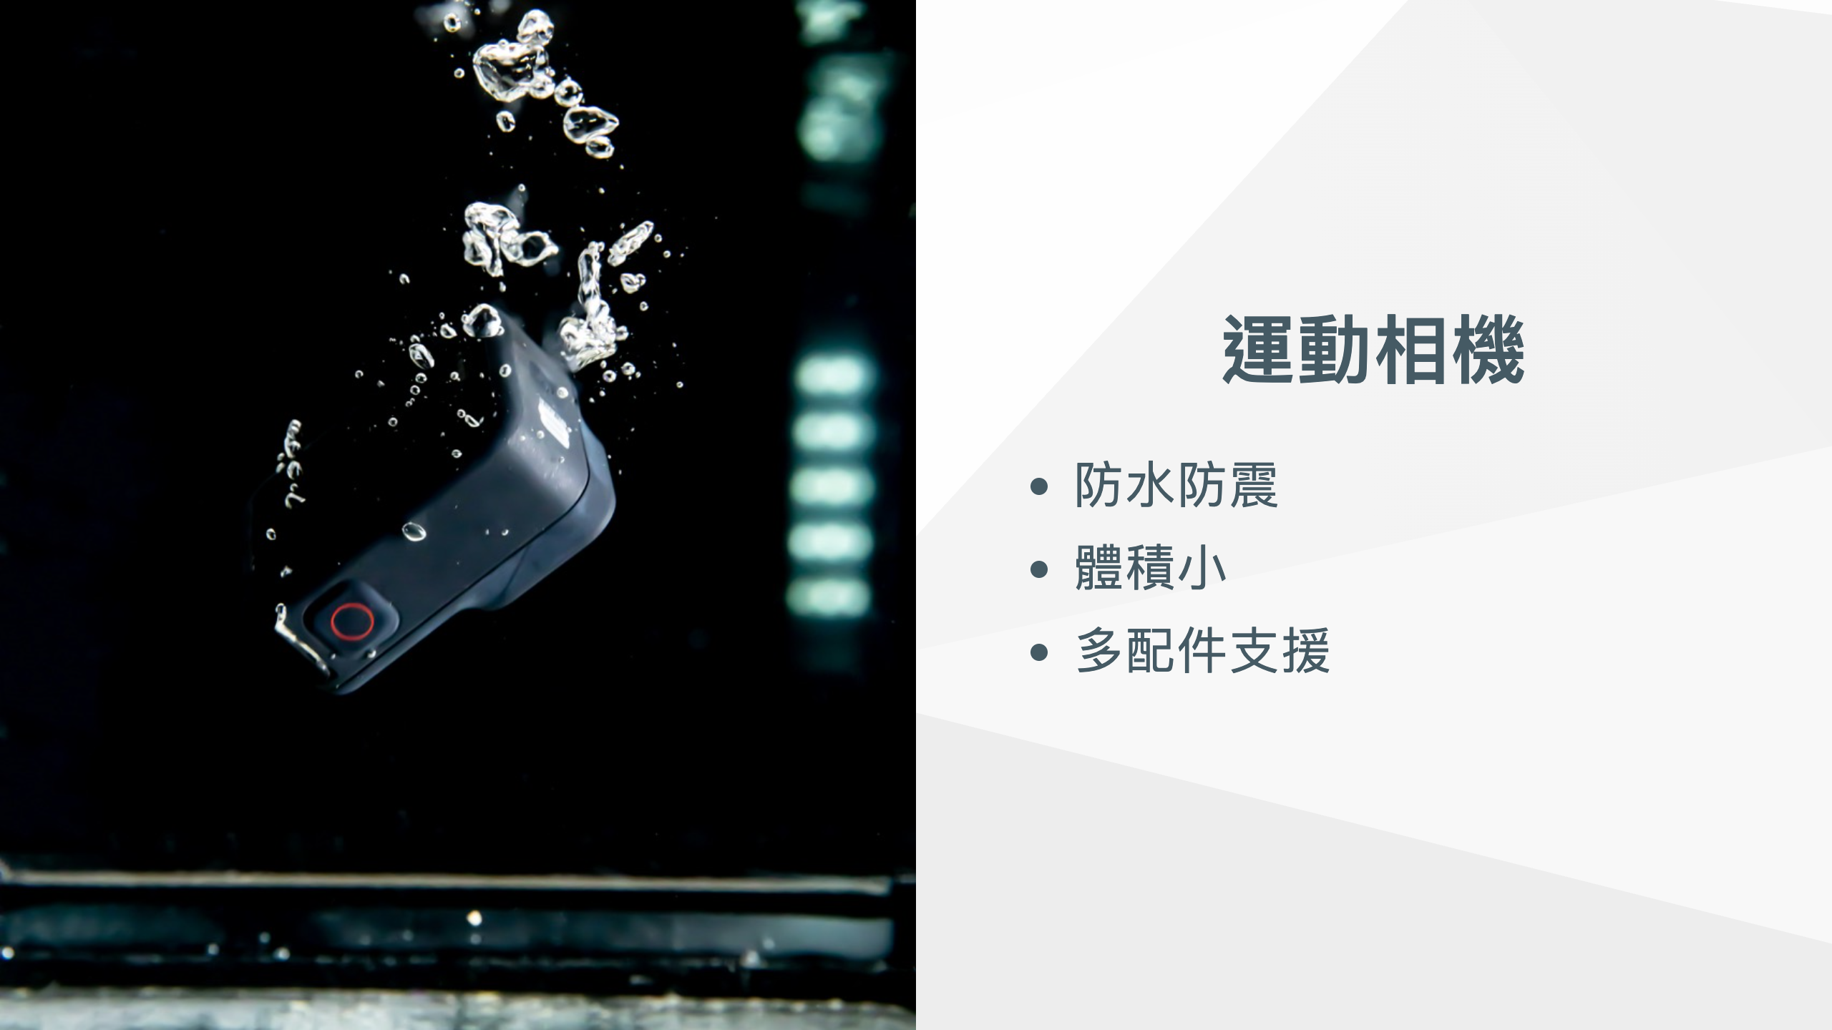

Slide 7


Slide 8
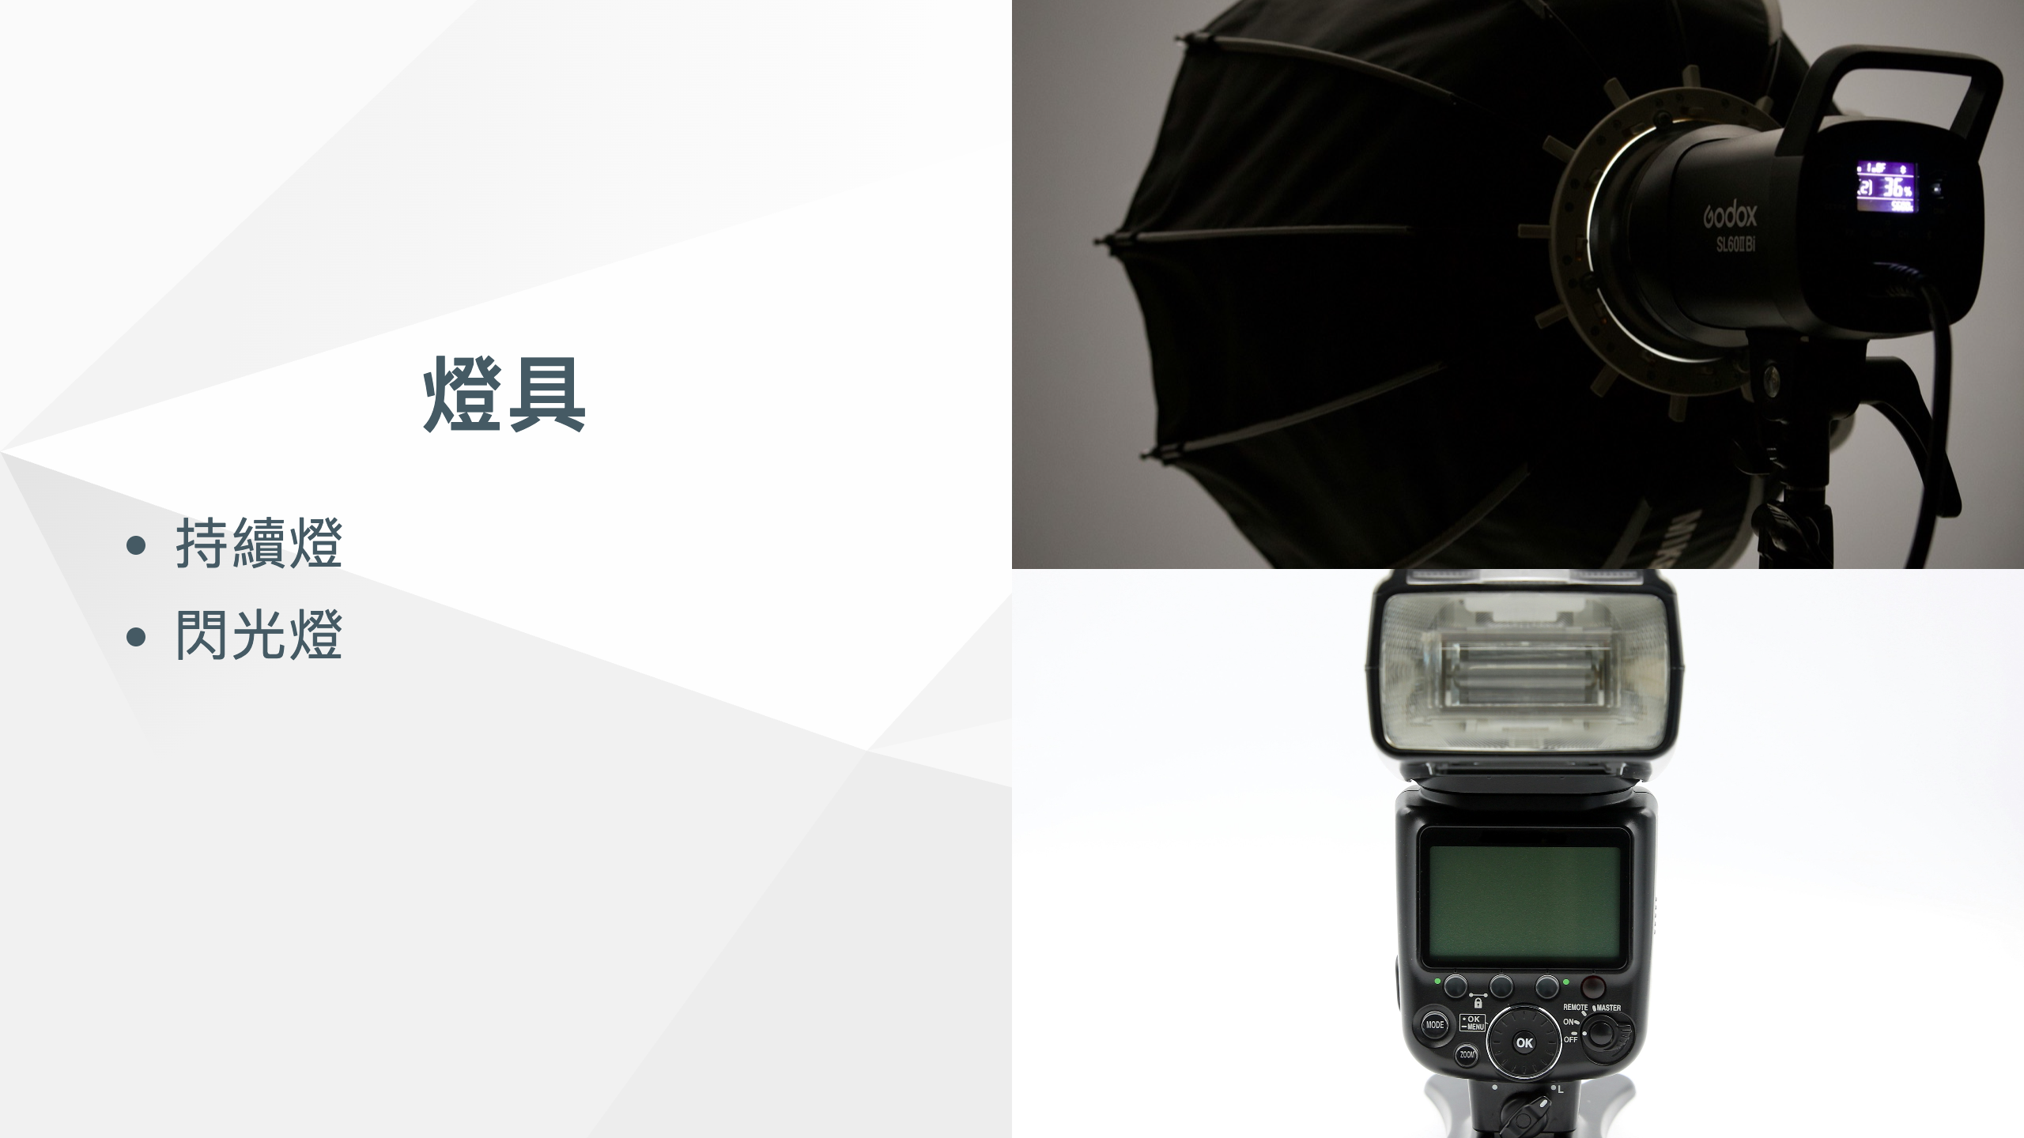

Slide 9


Slide 10


